Slide 3



Sandra Martinez Gerente de Soluciones Comunicaciones Unificadas. Oscar Maqueda Gerente de Soluciones Productividad. Oscar Mozo Office 365 Product Marketing Manager.
Roadmap e innovación en Microsoft Office 365

Slide 4

THE WORLD HAS CHANGED

Slide 5


Ahora el mundo es una red gigante

Slide 6



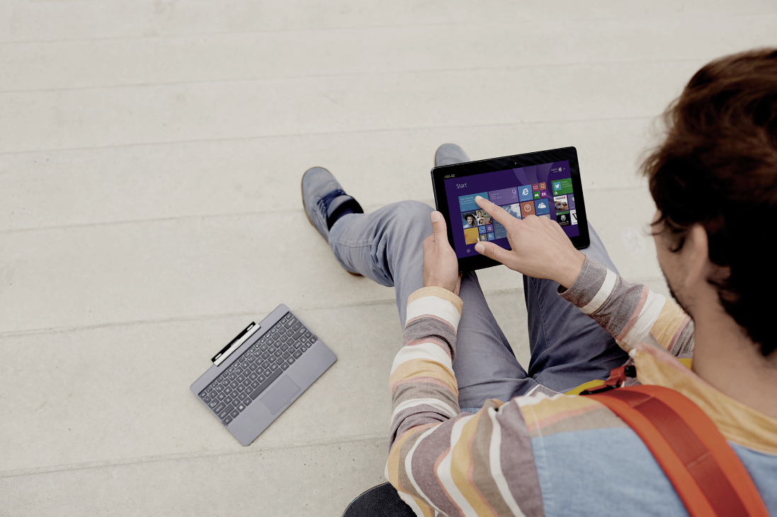
Una nueva vision de productividad
.
Móvil
Social
Inteligente
Natural

Slide 7
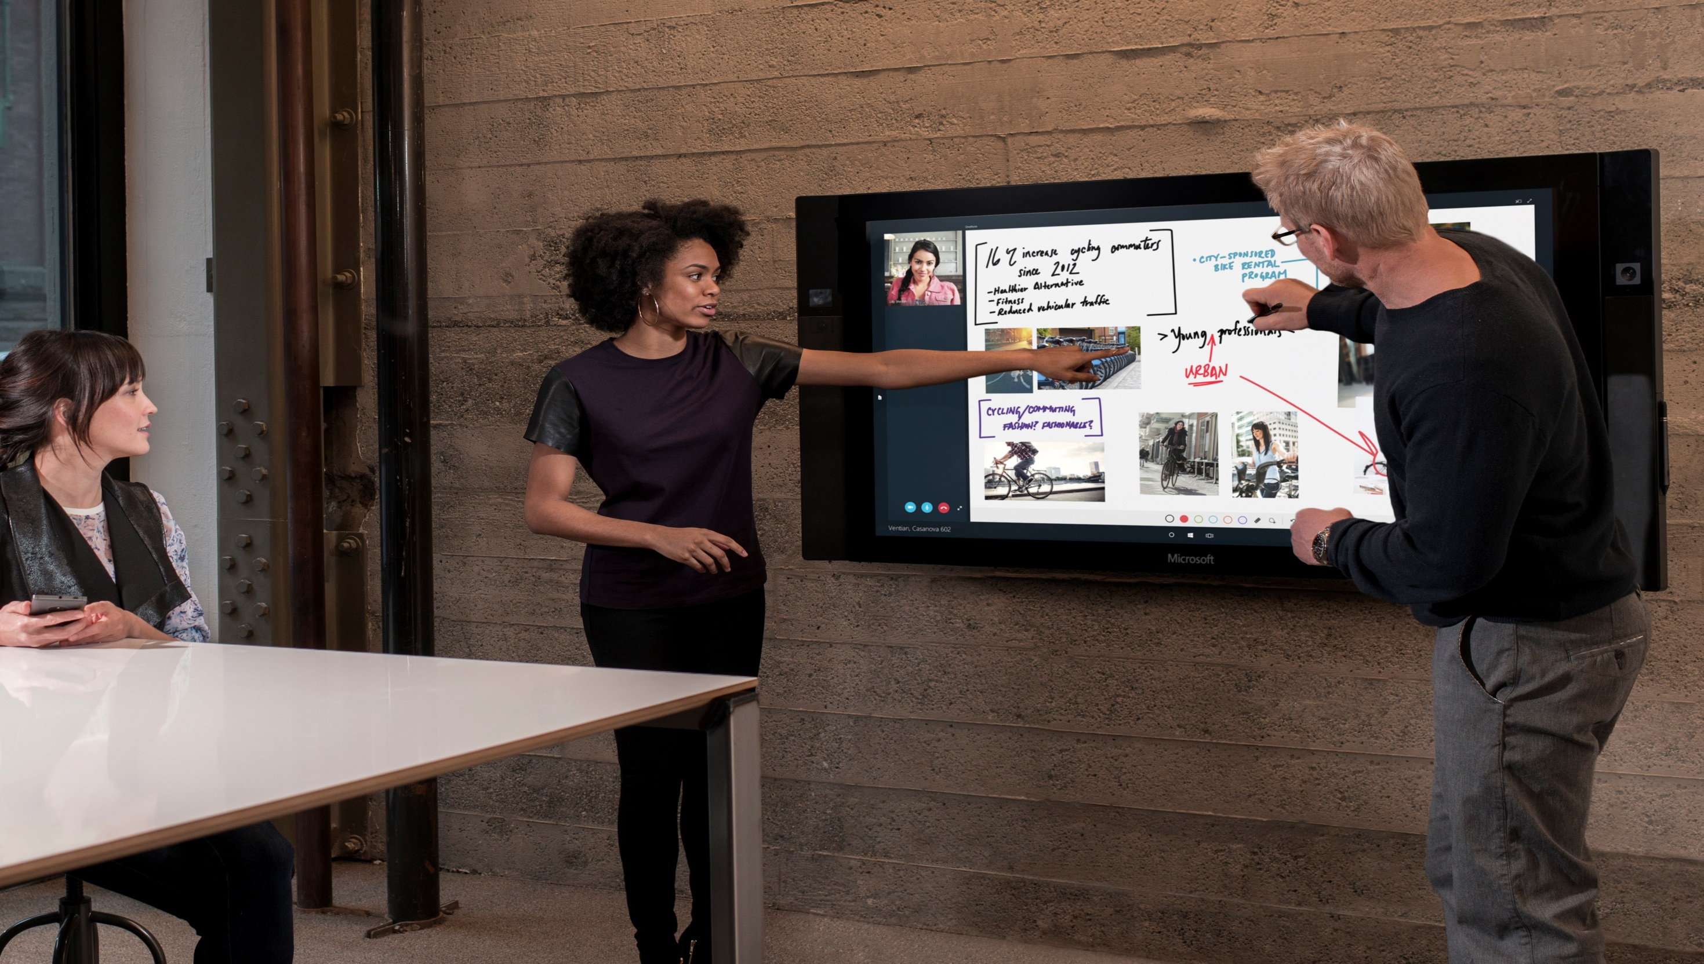

MODERN
WORKPLACE
MICROSOFT 2015

Slide 8
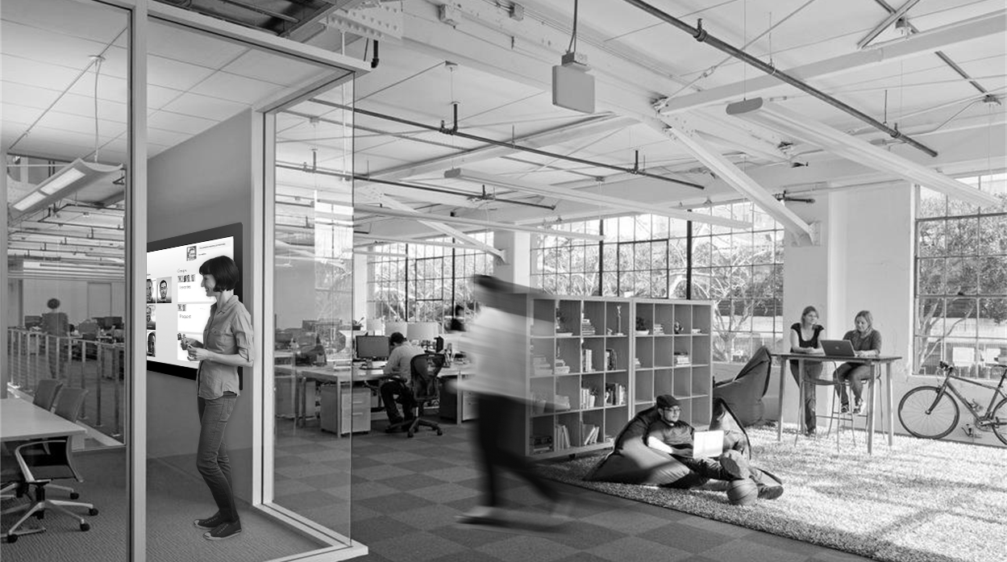



MODERN WORKPLACE
UBIQUITOUS COLLABORATION

Slide 9
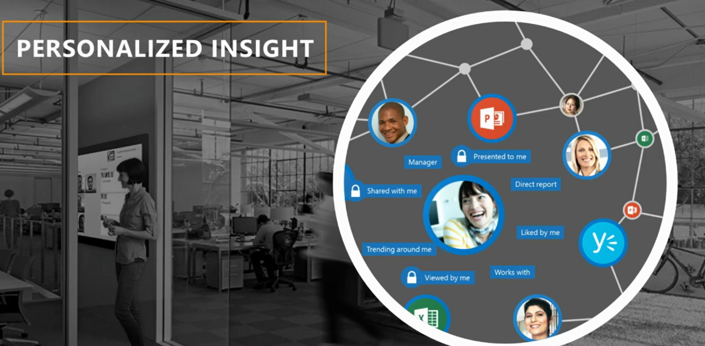
Yammer - Delve – Sway
6x
96% of people prefer co-working spaces for the community of innovation they provide.
People value communities of innovation that provide access to knowledge and accelerate their learning
COWORKING SPACES
Big Data aplicado a Enterprise Social

Slide 10
Demo Social

Slide 11
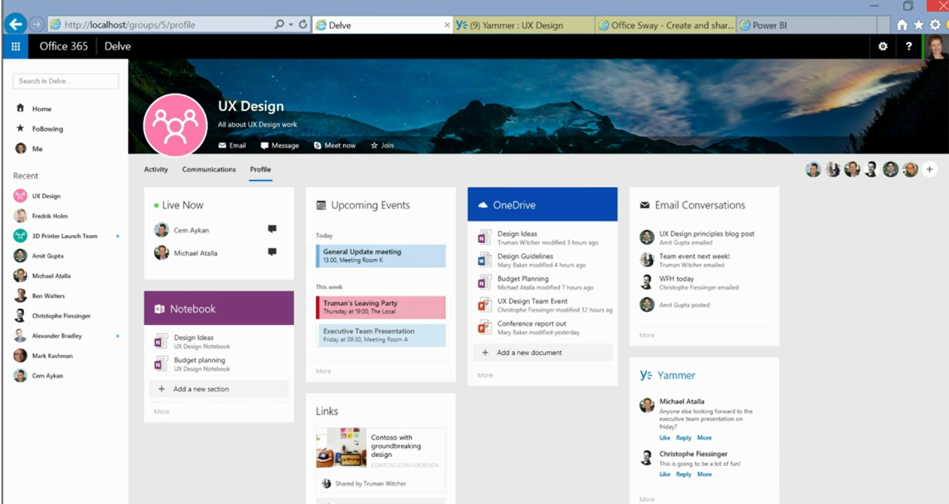

Slide 12


MODERN CONTENT CREATION

Slide 13
Roadmap
Currently rolling out
Mobile sharing UX
DLP policy tips
Product Experience
S
t
a
r
t
Q2 2015
Q3 2015
Q4 2015
Planned
(no timelines)
New mobile PDF experience for iOS, Android
Send a link from Outlook Mobile on iOS, Android
Save to OneDrive for Business from OWA
Expiration of anonymous shares
Next-gen sync client (PC & Mac) (Preview)
Unified web UX
Mobile Offline files (read-only) for iOS, Android
Stop/revoke sharing control
Company-shareable links
Next-gen sync client (PC & Mac) (GA)
Windows 10 Universal app (including read-only offline files)
Offline mobile editing
Offline mobile folders
Mobile PDF annotation support for iOS, Android
Modern attachments for Outlook
Expiration of all external shares

Slide 14
Roadmap
Currently rolling out
Auditing & Reporting (preview)
Disable sync on unmanaged PC’s
DLP Phase 2 (preview)
Unified OneDrive API
Security, Control, Compliance, Developer
Q2 2015
Q3 2015
Q4 2015
Planned
(no timelines)
Migration API SDK
Office 365 Management Activity API (Auditing)
Storage quota control
Allowlist/Denylist external sharing domains
Archive of external sharing emails
Intune support for personal/business accounts
DLP Phase 3
Disable external sharing for specific users
Remove 20,000 file limit (ships with next-gen sync client)
Large file support (10Gb) (ships with next-gen sync client)
Unlimited Storage
DLP support for mobile apps
Cross-tenant sharing control
OneDrive usage reporting

Slide 15
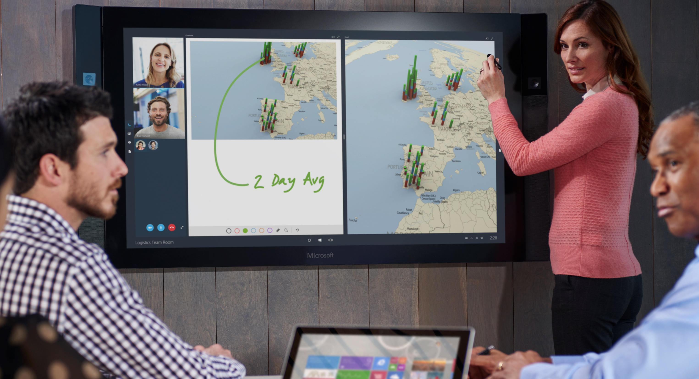

Comunicación Universal

Slide 16









Full Lync feature set
Design inspired by Skype
Skype for Business
Server, hybrid, and cloud
Enterprise grade

Slide 17
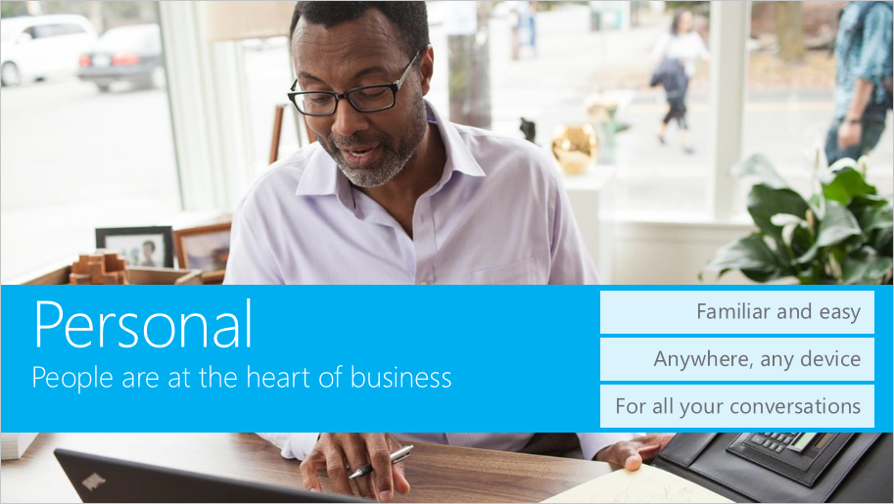

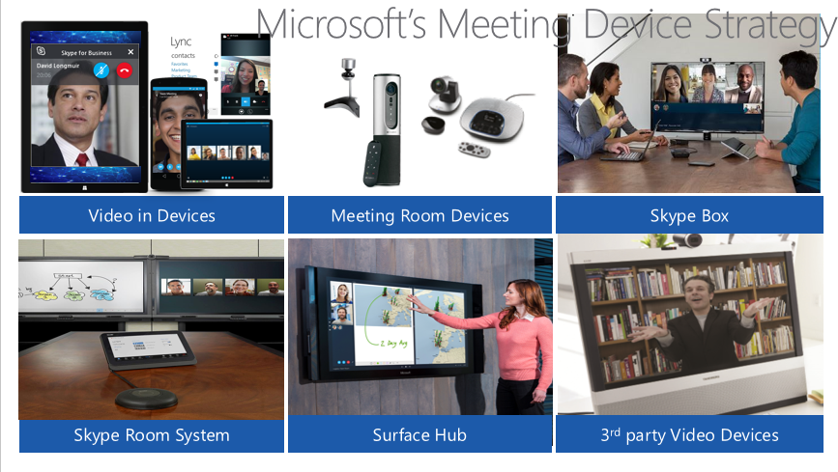
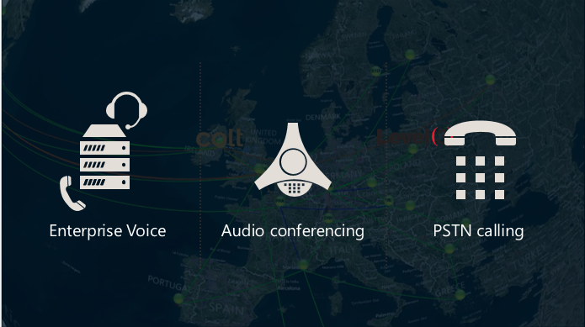
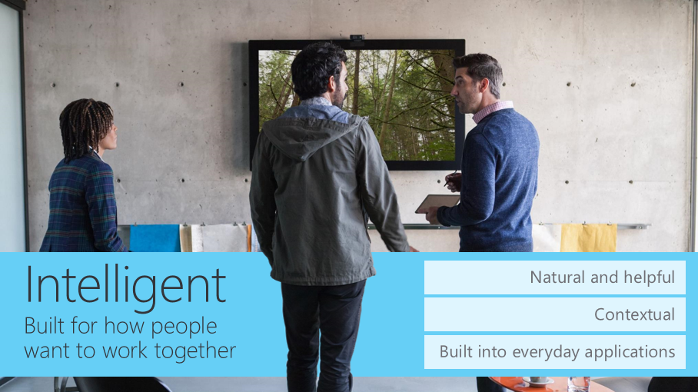
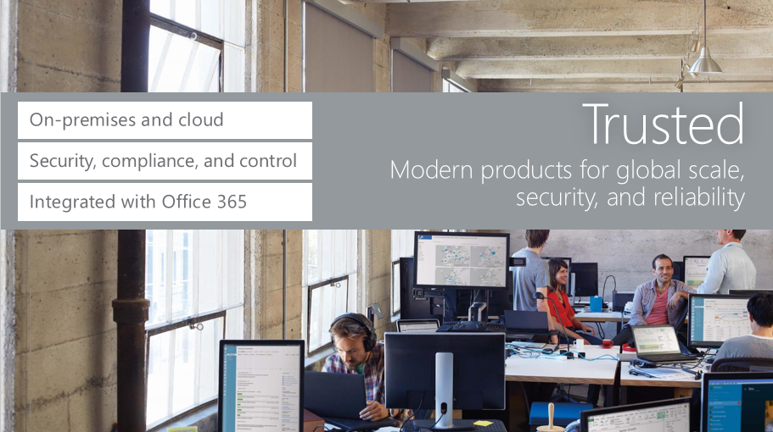

Slide 18
Demo

Slide 19

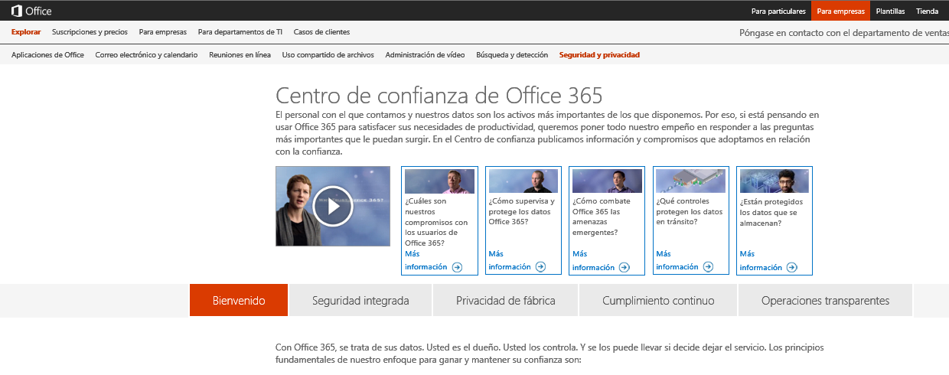
!
Más libertad y más seguridad

Slide 20
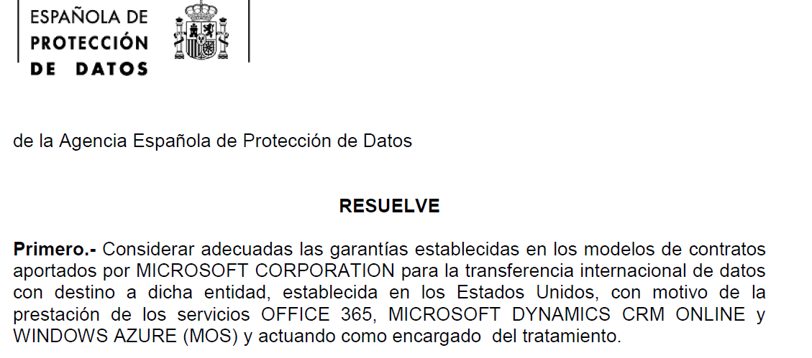
SEGURIDAD
Gestion de la seguridad
ISO27001
ISO27018
EU Model Clauses
EU Safe Harbour
DPA
FISMA
Basilea II
HIPAA
UK Gov
.
.
DATOS
USUARIO
APLICACION
HOST
RED INTERNA
RED PERIMETRAL
INSTALACIONES
http://www.agpd.es/portalwebAGPD/resoluciones/autorizacion_transf/auto_transf_2014/common/pdfs/TI-00032-2014_Resolucion-de-fecha-09-05-2014_de-MICROSOFT-CORPORATION_a-Estados-Unidos.pdf

Slide 21
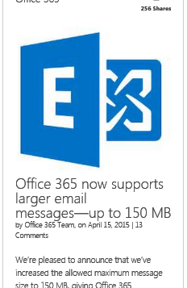

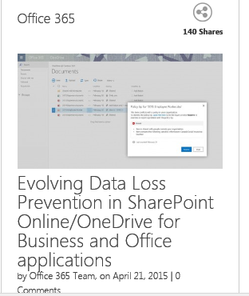
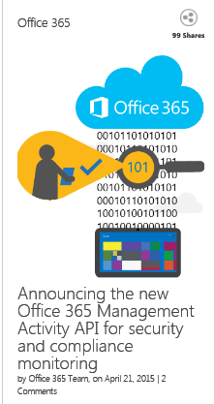
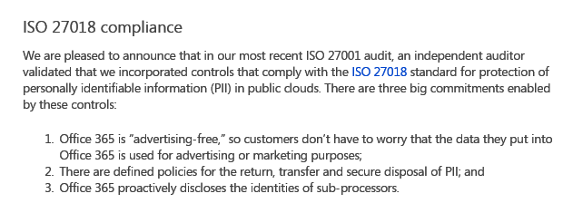
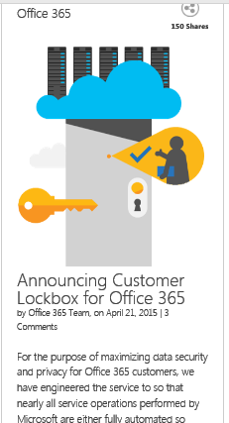
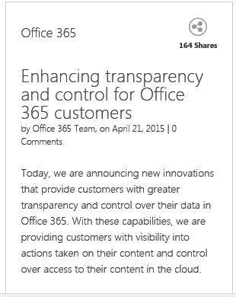

Slide 22



What you may be doing today….
SP/OneDrive
Data duplication
Non native end user experience
Incomplete information
Higher cost
Fragmented policy and experience
Exchange
Compliance and Governance
Solutions
Skype for Business
Social, IM (FB, Twitter, etc.
Third Party Archives

Slide 23






O365 Compliance…your peace of mind
SP/OneDrive
Office 365
Exchange
Compliance Center
Skype for Business
Archiving
eDiscovery
DLP
Auditing
Device Protection
and more…
And more…
EXO
SPO/OneDrive
Skype
Yammer
Social, IM (FB, Twitter, etc.
Partner Ecosystem (APIs, Experiences)
Third Party Archives
Ingestion
Review
Auditing
Alerting
and more…
And more…

Slide 24
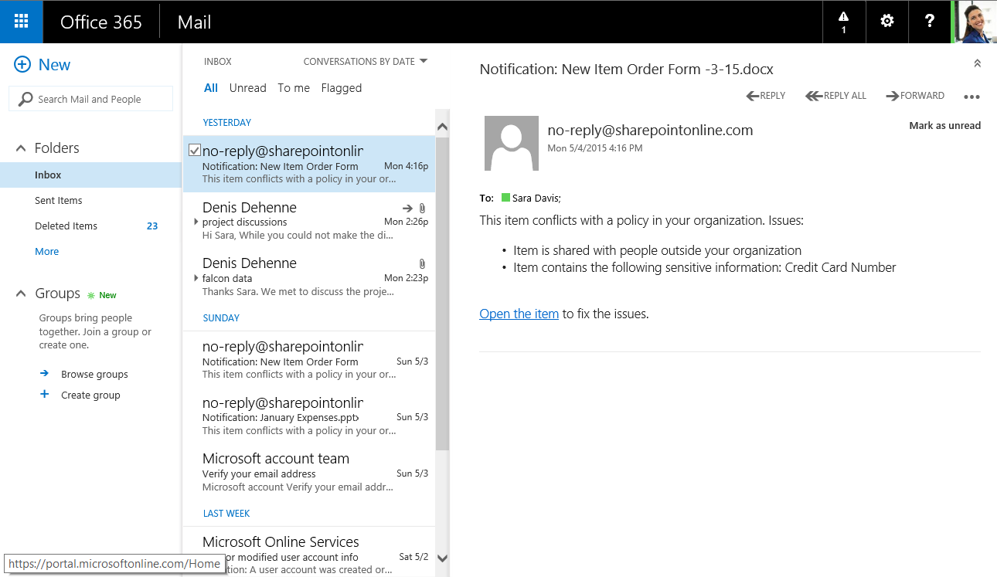
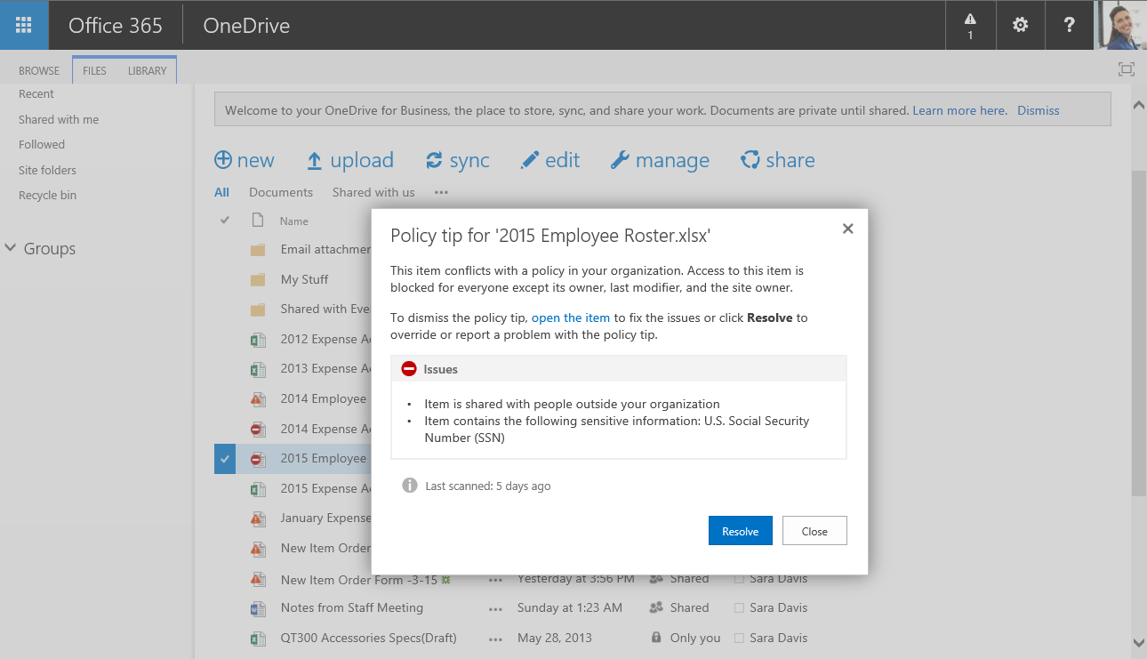
Policy tips in SharePoint and OneDrive

Slide 25
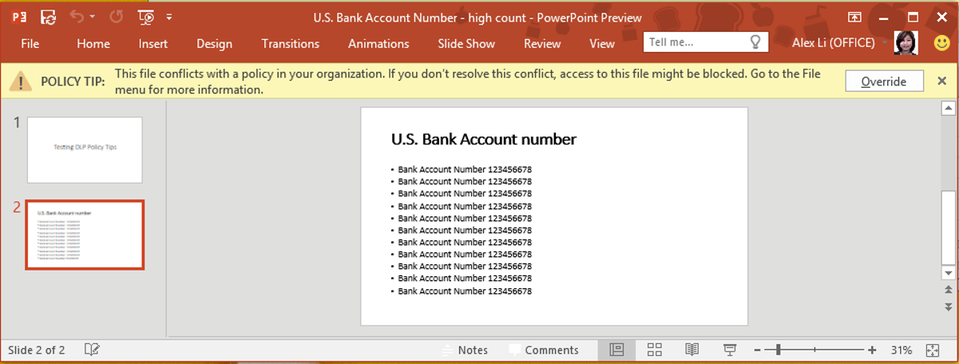
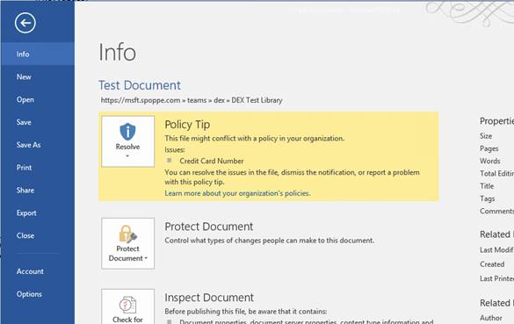
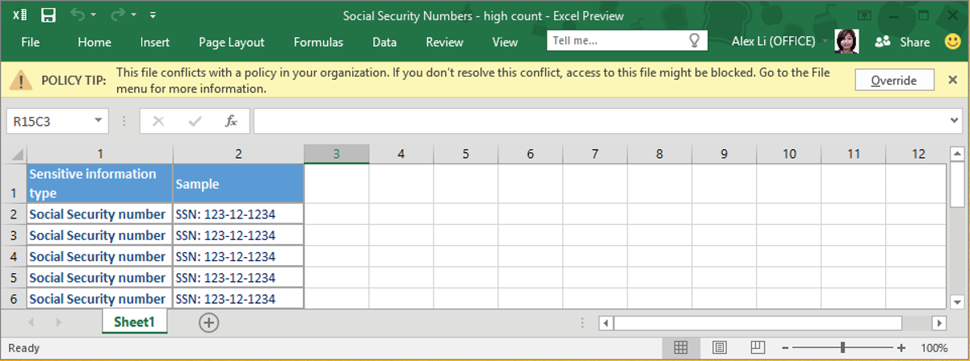
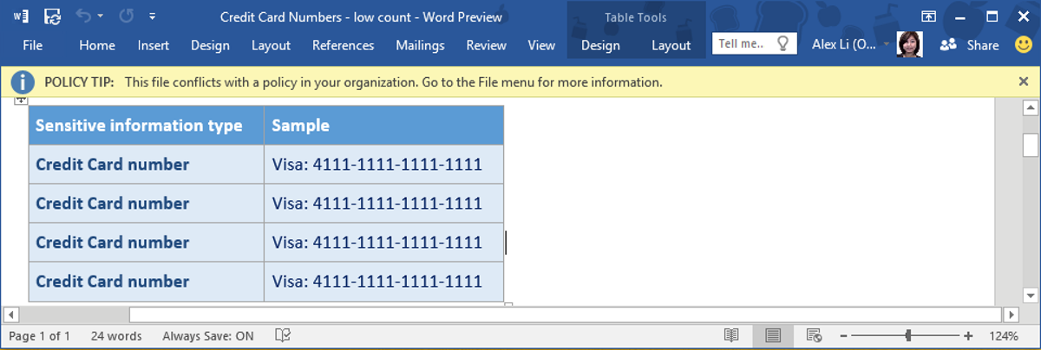
Policy tips in Office clients

Slide 26
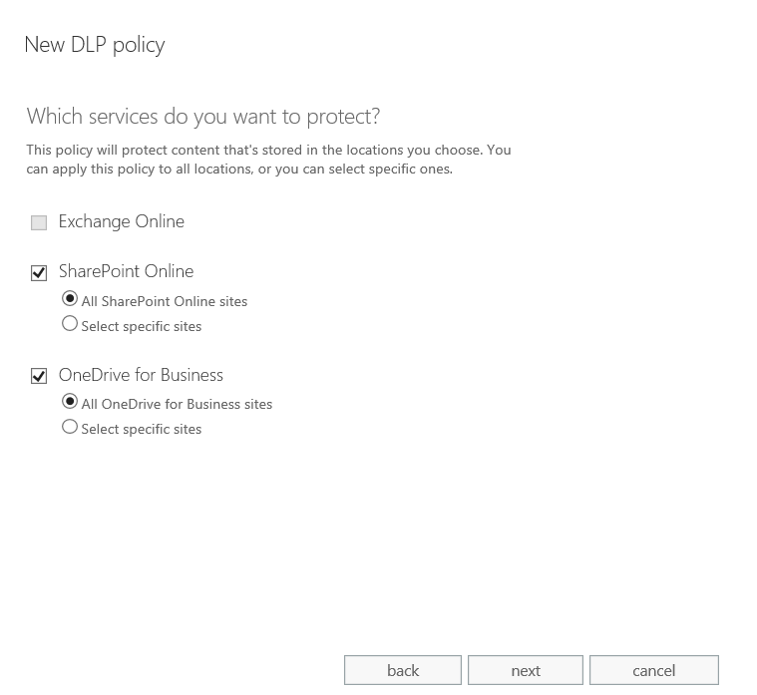
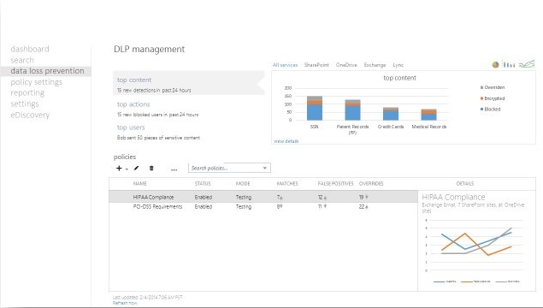
Data Loss Prevention in Compliance Center
Manage DLP policies across O365 workloads
One policy definition independent of workload
One policy lifecycle
One set of sensitive type definitions
New DLP Policy from Template
Import DLP Policy

Slide 27
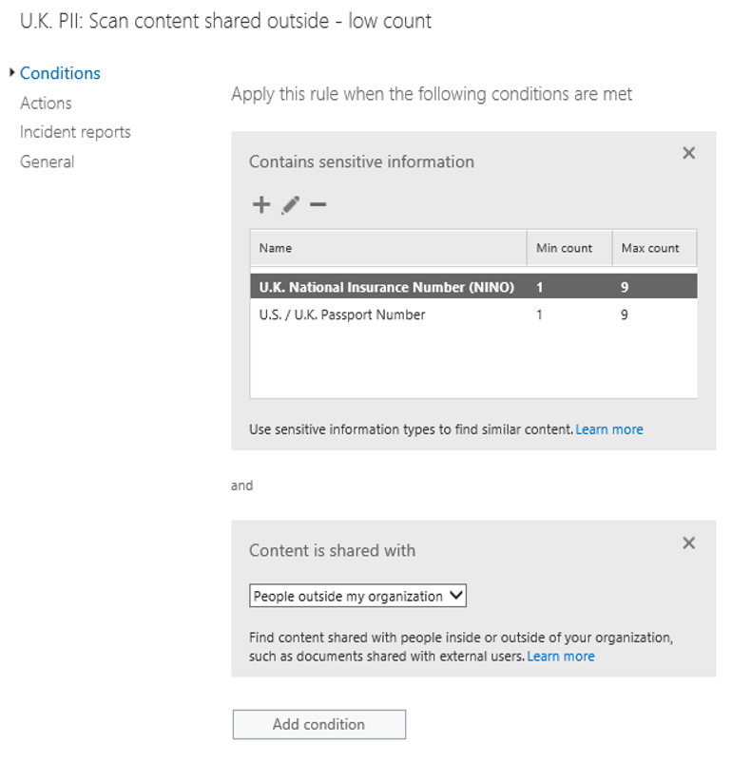
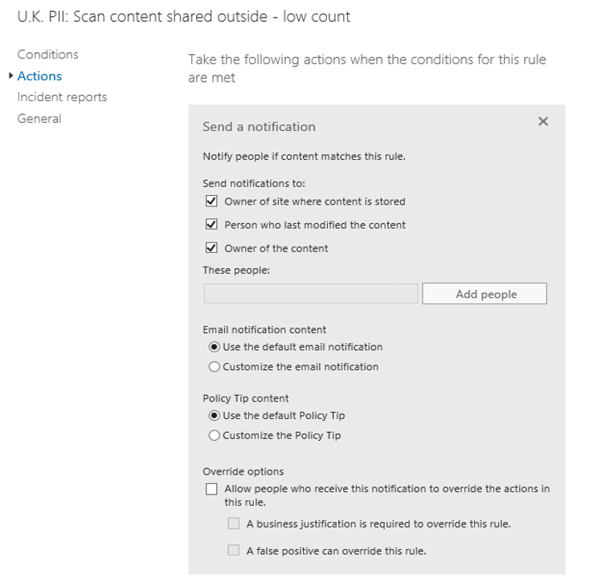
DLP policy rules
ACTIONS
CONDITIONS
Set of conditions and resulting actions that describe the policy objective
Take action to enforce policy
Range of actions to model the business requirements for protection of sensitive information from audit, notification, override to block
Actions normalized for different workload experiences

Slide 28
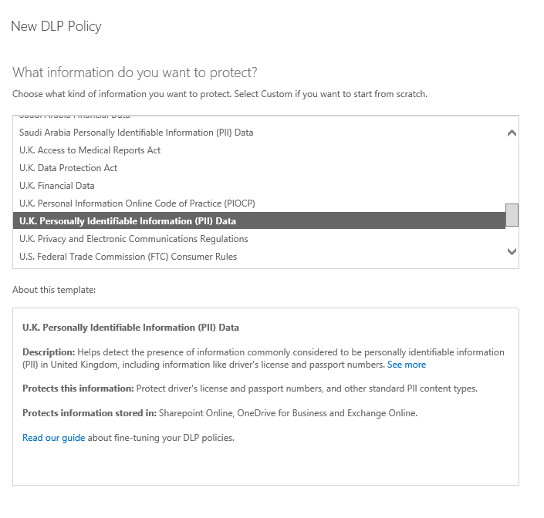
DLP policy templates
Built-in templates based on common regulations from around the globe
Import DLP policy templates from partners
Build your own

Slide 29
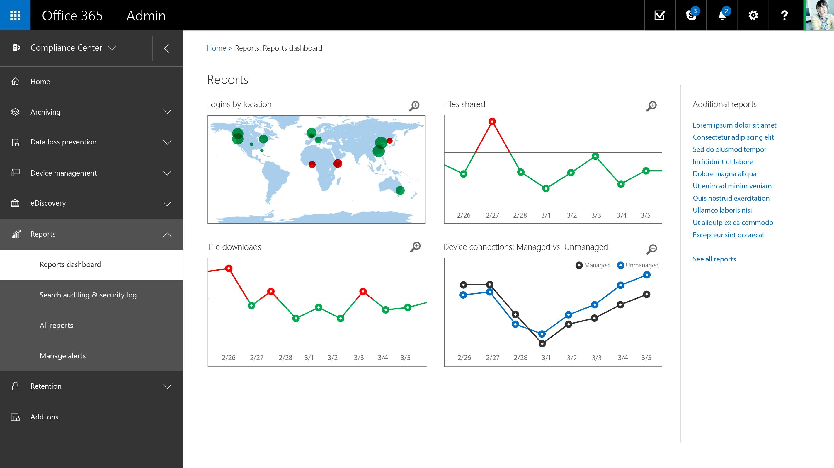

Slide 30
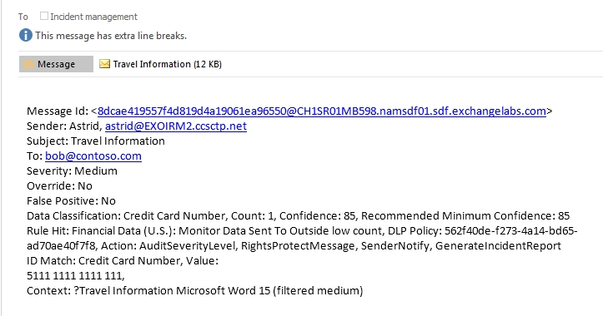
Real time notifications
MATCH DETAILS
AUDIT DATA
CLASSIFICATION
RULE DETAILS

Slide 31
Una nueva vision de productividad
.
Móvil
Social
Inteligente
Natural

Slide 32
MUCHAS GRACIAS

